Slide 1
IEEE STANDARDS
In 1985, the Computer Society of the IEEE started a project, called Project 802, to set standards to enable intercommunication among equipment from a variety of manufacturers. Project 802 is a way of specifying functions of the physical layer and the data link layer of major LAN protocols.
Topics discussed in this section:
Data Link Layer
Physical Layer
13.<number>

Slide 2

Figure 13.1 IEEE standard for LANs
13.<number>

Slide 3
Ethernet
Ethernet is a popular, relatively inexpensive, easy-to-install LAN architecture with the following characteristics:
  Uses the CSMA/CD media access control.
  Data transmission normally occurs at 100 Mbps (10Mbps in the early forms and 10Gbps in the most recent forms).
  Typically implemented in a star topology (early versions used bus topology as well).
  Ethernet LANs are normally distinguished by the type of cable they use Twisted Pair (Thinnet or Thicknet were also used in the past).
The Ethernet architecture conforms to most but not all of the IEEE 802.3 specification (the physical layers are identical but the MAC layers are somewhat different).
An Ethernet LAN is often described in terms of three parameters: transmission rate, transmission type, and segment distance or cable type.
  "100baseT" means:
    100 - transmission rate or through put of 100Mbps
    base - transmission type is baseband rather than passdband (i.e., the signal is placed directly on the cable, one signal at a time)
    T – the cable type (e.g. Twisted pair)
Few types of Ethernet: 10Base2, 10Base5, 10BaseT and 10BaseF, 100BaseT, 100BaseF, etc..

Slide 4

Figure 13.2 HDLC frame compared with LLC and MAC frames
13.<number>

Slide 5
Data Link Layer
Handles framing, flow control, error control and medium access control.
In IEEE project 802, flow control, error control and part of the framing duties are collected into one sub-layer called the Logical Link control (LLC).
Framing is handled in both the LLC sublayer and the MAC sublayer.
13.<number>

Slide 6
Logical Link Control Sub-layer
LLC provides one single data link control protocol for all IEEE LANs.
Framing
LLC PDU contains
Control – Flow and error control
Destination Service Access Point (DSAP)
Source Service Access Point (SSAP)
Need for LLC
To provide flow and error control for the upper layer protocols.
13.<number>

Slide 7
Medium Access Control (MAC)
In Aloha, decisions to transmit are made without paying attention to what other nodes might be doing
Ethernet uses CSMA/CD – listens to line before/during sending
If line is idle (no carrier sensed)
  send packet immediately
  upper bound message size of 1500 bytes
  must wait 9.6us between back-to-back frames
If line is busy (carrier sensed)
  wait until idle and transmit packet immediately
    called 1-persistent sending
If collision detected
  Stop sending and jam signal
  Try again later
13.<number>

Slide 8

Figure 12.9 Vulnerable time in CSMA
12.<number>

Slide 9

Figure 12.10 Behavior of three persistence methods
12.<number>

Slide 10

Figure 12.11 Flow diagram for three persistence methods
12.<number>

Slide 11

Figure 12.12 Collision of the first bit in CSMA/CD
12.<number>

Slide 12

Figure 12.13 Collision and abortion in CSMA/CD
12.<number>

Slide 13

Figure 12.14 Flow diagram for the CSMA/CD
12.<number>

Slide 14

Figure 12.15 Energy level during transmission, idleness, or collision
12.<number>

Slide 15
Exponential Backoff
If a collision is detected, delay and try again
Delay time is selected using binary exponential backoff
  1st time: choose K from {0,1} then delay = K * 51.2us
  2nd time: choose K from {0,1,2,3} then delay = K * 51.2us
  nth time: delay = K x 51.2us, for K=0..2^{n} – 1
    Note max value for k = 1023
  give up after several tries (usually 16)
    Report transmit error to host
If delay were not random, then there is a chance that sources would retransmit in lock step
Why not just choose from small set for K
  This works fine for a small number of hosts
  Large number of nodes would result in more collisions
13.<number>

Slide 16
Access Method: CSMA/CD
The Ethernet architecture does not have a regulated access to the medium.
Whenever multiple users have unregulated access to a single line, there is a danger of signals overlapping and destroying each other. Such overlaps, which turn the signals into unusable noise, are called collisions.
As traffic increases on a multiple-access link, so do collisions.

Slide 17
Access Method: CSMA/CD
The access mechanism used in an Ethernet is called carrier sense multiple access with collision detection CSMA/CD
In CSMA/CD system, any workstation wishing to transmit must first listen for existing traffic on the line. A device listens by checking for a voltage. If no voltage is detected, the line is considered idle and the transmission is initiated. During the data transmission, the station checks the line for the extremely high voltages that indicate a collision.

Slide 18
If a collision is detected, the station quits the current transmission and waits a predetermined amount of time for the line to clear, then sends its data again.
Addressing
Each station on an Ethernet network has its own network interface card (NIC). The NIC usually fits inside the station and provides the station with a six-byte physical address. The number on the NIC is unique.
Data Rate
Ethernet LANs can support data rates between 1 and 100Mbps.

Slide 19
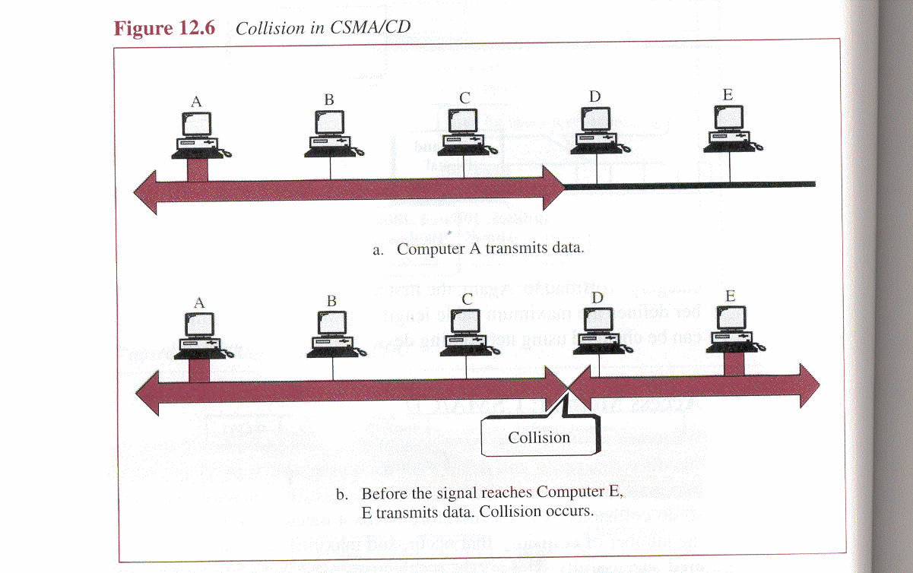

Slide 20

IEEE 802.3 MAC Frame

Slide 21

Min and Max Frame Length

Slide 22

Ethernet Addresses
48 bits (6 bytes) in length
Uniquely assigned to each Ethernet network interface card (NIC)
Usually written in hexadecimal notation
E.g.,

Slide 23

Unicast vs. Multicast Addresses
A unicast address defines one recipient
A multicast address defines a group of recipients
The broadcast address defines a group of all stations in the same LAN
  A special case of multicast addresses
  All bits are 1s

Slide 24
Example 13.1
Define the type of the following destination addresses:
a. 4A:30:10:21:10:1A b. 47:20:1B:2E:08:EE
c. FF:FF:FF:FF:FF:FF
Solution
To find the type of the address, we need to look at the second hexadecimal digit from the left. If it is even, the address is unicast. If it is odd, the address is multicast. If all digits are F’s, the address is broadcast. Therefore, we have the following:
a. This is a unicast address because A in binary is 1010.
b. This is a multicast address because 7 in binary is 0111.
c. This is a broadcast address because all digits are F’s.
13.<number>

Slide 25
Example 13.2
Show how the address 47:20:1B:2E:08:EE is sent out on line.
Solution
The address is sent left-to-right, byte by byte; for each byte, it is sent right-to-left, bit by bit, as shown below:
13.<number>

Slide 26
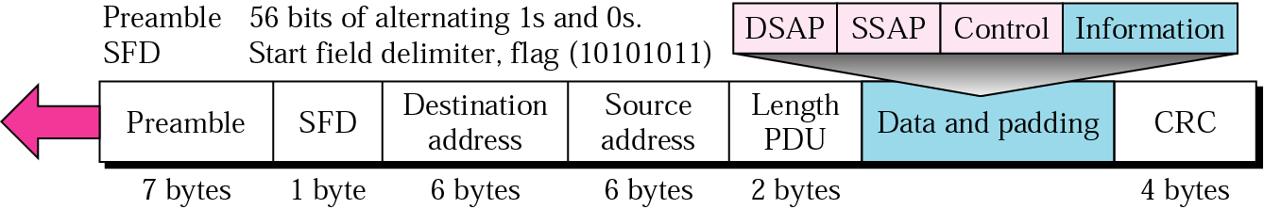
802.3 MAC Frame Format
Ethernet traffic is transported in units of a frame called the Ethernet Datagram
The frame consists of a set of bits organized into several fields
IEEE 802.3 specifies one type of frame containing seven fields:
802.3 MAC frame

Slide 27
Preamble
The preamble contains seven bytes (56 bits) of alternating 0s and 1s that alert the receiving system to the coming frame and enable it to synchronize its input timing.
Start Frame delimiter SFD
The SFD tells the receiver that everything that follows is data, starting with the addresses.
Destination Addresses DA
The DA field contains the physical destination address (six bytes) of the packet’s next destination.
If the packet must across from one LAN to another to reach its destination, the DA field contains the physical address of the router connecting the current LAN to the next one.

Slide 28
Source Address
The SA field contains the physical address ( six bytes) of the last device to forward the packet.
That device can be the sending station or the most recent router to receive and forward the packet.
Length/type of Protocol Data Unit (PDU)
This field contains two bytes indicating the number of bytes in the PDU.
If the length of the PDU is fixed, this field can be used to indicate type, or as a base for other protocols.

Slide 29
Protocol Data Unit PDU
The PDU is generated by the upper LLC sublayer, then linked to the 802.3 frame.
The PDU can be anywhere from 46 to 1500 bytes long, depending on the type of frame and the length of the information field.
CRC
The last field in the 802.3 frame contains the error detection information, in this case CRC-32

Slide 30
Padding & Overhead
The minimum length of data in an ethernet frame should be 46 bytes
If the length of the message that you want to send is less than 46 bytes, then“padding” is added
These are extra bits added to bring the total of the message length up to 46 bytes
The bytes in a frame that do not constitute the actual message that we are interested in sending are called overhead
  The Ethernet frame has 26 bytes of overhead (8+6+6+2+4)
  If you had 100 bytes of data to send, you’d have to send 126 bytes of data
  How much overhead is transmitted within the 126 bytes of data?
    26/126 = 21%

Slide 31
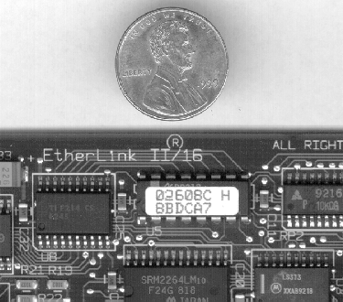
Ethernet NIC
The Network Interface card allows computers to communicate with each other through the network
Each NIC has a 48-bit unique hexadecimal address called the MAC address
A computer or device on a network can be reached by its MAC address through the NIC card
An example of a MAC address: A1B2C3D4E5F6
The first 6 hex digits in the MAC address is the OUI (organizationally unique identifier), assigned by the IEEE to each manufacturer (e.g. Cisco, Intel etc). The rest of the MAC address can be assigned in any way by the manufacturer to the individual networking devices that it manufactures

Slide 32
Implementation
Ethernet LANs are configured as logical buses, although they may be physically implemented in bus or star topologies.
Each frame is transmitted to every station on the link but read only by the station to which it is addressed.

Slide 33
13-2 STANDARD ETHERNET
The original Ethernet was created in 1976 at Xerox’s Palo Alto Research Center (PARC). Since then, it has gone through four generations. We briefly discuss the Standard (or traditional) Ethernet in this section.
Topics discussed in this section:
MAC Sublayer
Physical Layer
13.<number>

Slide 34

Figure 13.3 Ethernet evolution through four generations
13.<number>

Slide 35

Figure 13.8 Categories of Standard Ethernet
13.<number>

Slide 36
Standard Ethernet
Uses 1-persistent CSMA/CD
Slot time = RTT + Time required for jam seq.
Collision may occur only during first half of RTT and in 2nd half it is noticed
Max. cable length = Propagation speed x slot time/2 = 2x10^8x(51.2x10^-6)/2 = 5120m
But considering other delays, it is reduced to 2500m
Baseband signaling is used – Manchester scheme for data formatting – self synchronous, transition at each bit interval
10Base5 – Bus, thick coaxial, 500m (to avoid excessive degradation) – uses taps and separate cables –collision happens in backbone cable only – to get more length repeaters used – max. 5 segments, each 500m
10Base2 – Bus, thin coaxial, 185m (flexible, cheap, more attenuation)
10BaseT – Star, 2 pairs of UTP, 100m (hub to station) – collision in hub only
10BaseF – Star, Fiber, 2000m
13.<number>

Slide 37
Changes in Standard Ethernet
Bridged LAN – Divides n/w into 2 or 3 independent n/ws
  increases BW (capacity) and separates collision domain
Switched LAN – Half duplexed Switch with multiple (N) ports for N stations and fast packet handling feature
  Full duplexed switched LAN – rate increases to 20Mbps to each station as 2 links used – No CSMA/CD is required as no collision
  MAC control layer b/w MAC and LLC for flow and error control
Standard Ethernet is connectionless – no flow and error control – no acknowledgement to sender
13.<number>

Slide 38
Fast Ethernet (802.3 u)
To compete with FDDI and to backward compatible with Standard Ethernet
  Same 48 bit addr, frame format, and min. and max. frame length
  100Mbps rate – Star topology – Hub (half duplexed) or switch (full duplexed)
  Auto-negotiation of mode and rate by stn or hub/switch
  As Manchester coding needs more BW, uses NRZ-I (not self synchronous), so additionally have block encoding 4B/5B
    100Base T4 – 4 cat3 UTP wires – MLT - 100m – 8B/6T
    100Base TX – 2 cat5 UTP – MLT- 100m – 4B/5B – 125 Mbps
    100Base Fx – 2 Fiber – NRZ-I - 100m – 4B/5B – 125 Mbps
13.<number>

Slide 39
High speed Fiber - Star Ethernets
Gigabit Ethernet (802.3 z) uses 8B/10B – 8x125 Mbps
  1000Base SX – 2 wire shortwave fiber – 550m
  1000Base LX - 2 wire long wave fiber – 5000m
  1000Base CX – 2 wire copper STP – 25m
  1000BaseT – 4 wire UTP – 100m(no block code)
10 Gigabit Ethernet – 802.3 ae
  10GBase SR – shortwave (850nm) multimode – 300m
  10GBase LR – long wave (1310nm) single mode – 10Km
  10GBase EW – Extended long wave (1550nm) single mode – 40Km
13.<number>

Slide 40
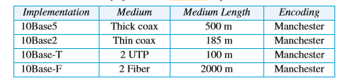

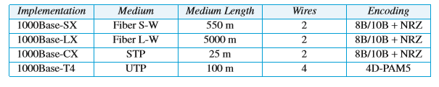
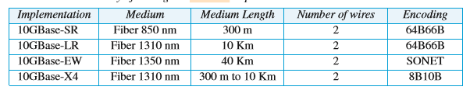
Ethernet Evolution
Standard
Fast
Gigabit
10 Gigabit

